Slide 1
Fraud Analytics
USC DSO 562
Spring 2020

Slide 2
1/16 Class 1 - Overview
My background
What we’ll cover during the semester
Grading, homework, projects
What is fraud
How to use a fraud score
Tax fraud example
Good plot formats
Data Quality Report (DQR)
Assignment Homework 1, Project 1

Slide 3
Who Am I
Stephen Coggeshall, PhD Nuclear Engineering
Worked 11 years at Los Alamos National Lab doing nuclear fusion research
Began doing machine learning in 1990
Cofounded three analytics companies
CASA (1995) -> HNC/FICO (2000)
Los Alamos Computational Group (2002) -> Morgan Stanley (2004)
ID Analytics (2002) -> LifeLock (2012) -> Symantec (2017) –> LexisNexix (2020)
Chief Analytics and Science Officer IDA, LifeLock, (retired)
Oversee technology, analytics for risk and marketing analytics
Teaching at USC, UCSD, Fraud Analytics, 528, 510

Slide 4
Fraud Problems I’ve Worked On
IRS tax preparer fraud
Credit card transaction fraud
Credit card merchant fraud
Healthcare claims fraud and abuse
Identity fraud for
Financial services (credit cards, loans, payday loans…)
Telecommunications (Sprint, TMobile, ATT, Verizon…)
Government agencies (SSA, VA, IRS)

Slide 5
What We’ll Cover
Types of fraud, how is it committed, how to catch
Various algorithmic approaches to fraud detection, supervised and unsupervised
You will work on 3 group projects and build fraud algorithms. One unsupervised and two supervised fraud algorithms
Topics for the course:
Fraud algorithms: what they are, how they are used
Data: exploration, analysis, cleaning, scaling, missing fields
Feature engineering: creating expert variables, categorical variables, entities, profiles, linkage/graph variables
Feature selection: filter, wrapper, embedded methods
Model building: machine learning methods, overfitting
Model evaluation: Measures of goodness
Prepare business reports and a presentation

Slide 6
Outline of Semester

Slide 7
Assignments and Grading
10 homeworks at 15 pts each (150)
Midterm exam 50 points (50)
3 group projects at 30 pts each (90)
Total possible points is 290
The final point scale will be adjusted so that the average final gradepoint is 3.5, halfway between B+ (3.3) and A- (3.7)

Slide 8
Survey room for background, skills, experience
What undergraduate degrees
What programming skills (SAS, R, Matlab, Python…)
What business experiences (jobs, internships…)

Slide 9
Define Fraud
Fraud:
A wrongful or criminal deception intended to result in financial or personal gain
Intentional misrepresentation in order to improperly receive something of value
Give Examples
For each, where/how does the problem happen
Who pays for/is harmed by it
How is the problem addressed/solved today

Slide 10
Anomaly or Fraud Detection?
Anomaly detection – find unusual events
Fraud detection is a subset of anomaly detection
Examples:
Detecting manufacturing errors
Monitoring data cleanliness
Cybersecurity, finding malware or intrusions
Finding unusual objects in images
Detecting terrorist activity
Finding suspicious candidates for fraud
The algorithms seek to find unusual events (fraud is unusual).
Some problems are supervised, some unsupervised

Slide 11
Predictive Models
We build business models to predict what a customer (account, household, business…) will do in the future
Examples: credit score, fraud score, marketing score…
These are of the form y = f(x) with many example records to learn this relationship from
The dependent variable y is what we are trying to predict from the dependent variables x using the model function f
When y is a continuous number we call it a regression problem and when y is a category (e.g., 0 or 1) we call it a classification
We typically use linear, logistic regression or nonlinear machine learning models to learn/fit the function f

Slide 12
What is a Fraud Score?
A score is the output of (typically) a binary classification model/algorithm. It quantifies the likelihood of something.
We build scores for fraud, credit, target marketing…
A fraud score is the output of a statistical model that predicts the likelihood that an event is a fraud attempt.
Events that we score for fraud include credit card transactions, applications for new accounts, tax returns, insurance claims…
The scores can be scaled to any useful range. Most risk scores (fraud and credit) range from 1 to 1000.
Credit scores: higher is better
Fraud scores: higher is worse

Slide 13
Kinds of Fraud Algorithms
Expert rule systems, filters
General statistical/Machine Learning models
Unsupervised
Autoencoders (linear, nonlinear)
z score outliers
Sometimes we do clustering first, then do these two (autoencoder, z score outliers)
Supervised
linear models: LinReg, LogReg, PCR, PLS…
Nonlinear: decision tree, neural nets, random forests, boosted trees, SVM, Bayesian nets…

Slide 14
High Level Process for Building a Fraud Algorithm
Understand the nature of the problem
Gather and explore the data (do a DQR)
Design overall modeling structure: supervised, unsupervised, inputs, outputs, training, testing, validation, how it will be evaluated
Design and build variables (use entities, groupings, profiles, linking)
Feature selection and/or dimensionality reduction
Examine results, select algorithm, finalize
Supervised
Baseline linear model
Several nonlinear models
Unsupervised
Function of z scores
Autoencoder

Slide 15
A Few Definitions
Fields – The columns values in the raw data file (e.g., name, address, product type, time, $ amount, event type…). Could be numeric, categorical, text…
Records – A single instance of a measurement of all fields. It’s a vector of many fields, sometimes followed by a label. It’s a single row in a matrix of a data set. Also called a data point.
Variables or inputs – The values that are inputs to the predictive models. These come from the data fields through cleaning, transformations and encodings. They’re almost always numeric because that’s what most ML models need.
Variable creation, feature engineering, variable encoding – The process of constructing thoughtful inputs to a model. Typically one examines the fields in the raw data, does analysis, cleaning, standardization, and then transformations and combinations of these fields to create special variables that are candidate inputs to models. Examples of this process are encoding of categorical variables, z-scaling, other normalizations and outlier suppression, nonlinear transformations such as taking the log or binning, construction of ratios or products of values.
Output, tag, label, y, target, dependent variable – The quantity or category that you’re trying to predict with a model. It could be a continuous value (called a regression problem) or a categorical value (called a classification problem). Many times for classification the target/output is just binary: yes/no, 0/1, good/bad.
Supervised modeling – Frequently in modeling one has an identified output that one is trying to predict for each record. The output or dependent variable is the target or dependent variable of the model, and we try to learn the functional relationship between the inputs and this output. This is called supervised learning since the learning algorithm is supervised during training by constantly looking at the error between the predicted and actual outputs.
Unsupervised modeling – Here we don’t have an output or dependent variable, all we are given is a set of independent variables. There are several things we can do with independent variables only, for example we can
Look for interrelationships between the variables, either linear (e.g. PCA) or nonlinear
Look for macro structure in the given data in input/independent variable space alone. Methods include PCA and clustering.
Look for outliers or anomalies in the records, looking only at the inputs/independent variables. This is frequently a task in building fraud models in situations when you have no labeled data, that is, no records that have already been determined to be fraud. Generally you look for what is normal in the data and then look for outliers to this typical data.

Slide 16
Fraud Algorithm Scores Records
We usually label the fraud records as 1 and the nonfrauds as 0
Records, events
field1 field2 field3 … fieldn label
field1 field2 field3 … fieldn label
field1 field2 field3 … fieldn label
…
time
text, number, characters, symbols…
Name, address, $s, time, event type…
Use fraud algorithm
Fraud
Algorithm
Record
Score (likelihood of fraud)
Each records gets a score appended to it
field1 field2 field3 … fieldn label score
field1 field2 field3 … fieldn label score
field1 field2 field3 … fieldn label. score
…

Slide 17
Two Different Kinds of Fraud Analyses
Forensic accounting – after-the-fact batch examination of a collection of events or data. The algorithm/variables can be created from all the data, regardless of time flow. Generally, time flow is not an important issue.
Real time fraud algorithms – process of scoring a flow of events one at a time. The algorithm can only look at past data, before the record it’s currently scoring. The variables for each record can be created only using the data on that record and in the past. Therefore time flow is very important in the model building process.

Slide 18
Fraud Score Distribution
field1 field2 field3 … fieldn label score
field1 field2 field3 … fieldn label score
field1 field2 field3 … fieldn label score
…
Typical score distribution for a fraud score:
Most records look OK
Number of records at that score
Small # records look bad
Fraud distributions are right skewed
0
Score
1
Low likelihood of fraud
GOOD
High likelihood of fraud
BAD

Slide 19
How To Use Fraud Score on Historical Data for Forensics
Build fraud model using historical data
Score all data records with model
Sort all records by the score
Work records in decreasing score order
Fraud
Algorithm
Record
Score (likelihood of fraud)
Number of records at that score
Investigate records from this end
0
Score
1
Low likelihood of fraud
GOOD
High likelihood of fraud
BAD
19

Slide 20
How To Use Fraud Score for Real Time
Build fraud model using historical data
Score historical data records with model
Look at distribution. Work with business to decide a score cutoff.
Score all new records as they come in
Flag/stop/divert any record that scores above the threshold
Decide location of score cutoff
Number of records at that score
0
Score
1
Low likelihood of fraud
GOOD
High likelihood of fraud
BAD
20

Slide 21
My First Fraud Problem: Tax Preparer Fraud
1992, Los Alamos National Lab project with the IRS
What is the business problem:
Find fraud committed by tax preparers
What was the situation when I took over the project:
Team building supervised fraud models looking for unusual tax returns
Using linear, logistic regressions, various clustering methods
Scored few hundred thousand returns, sent few hundred to IRS to investigate
IRS kept saying “nothing there”
Project had been going like this for about 18 months
What would you do?

Slide 22
Break

Slide 23
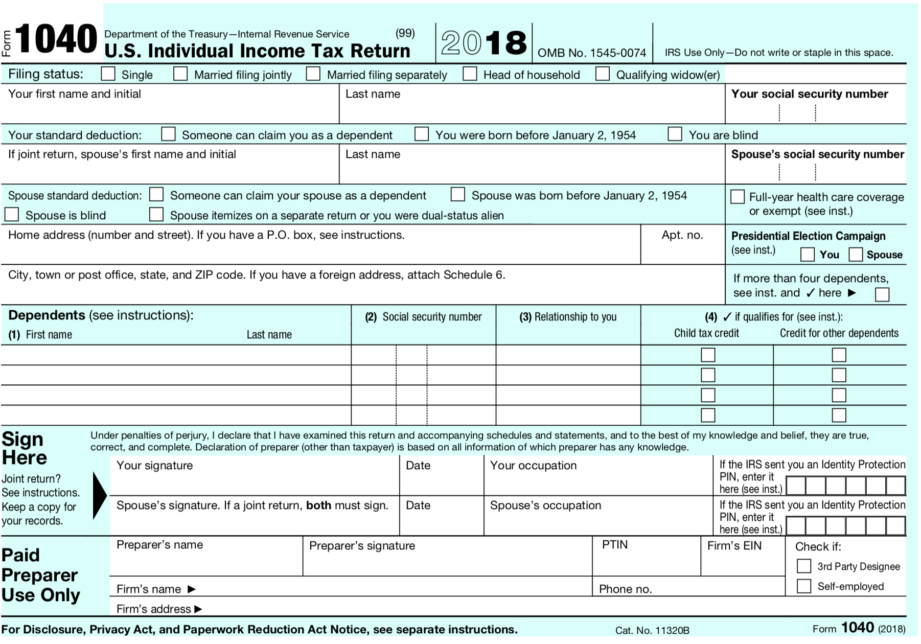
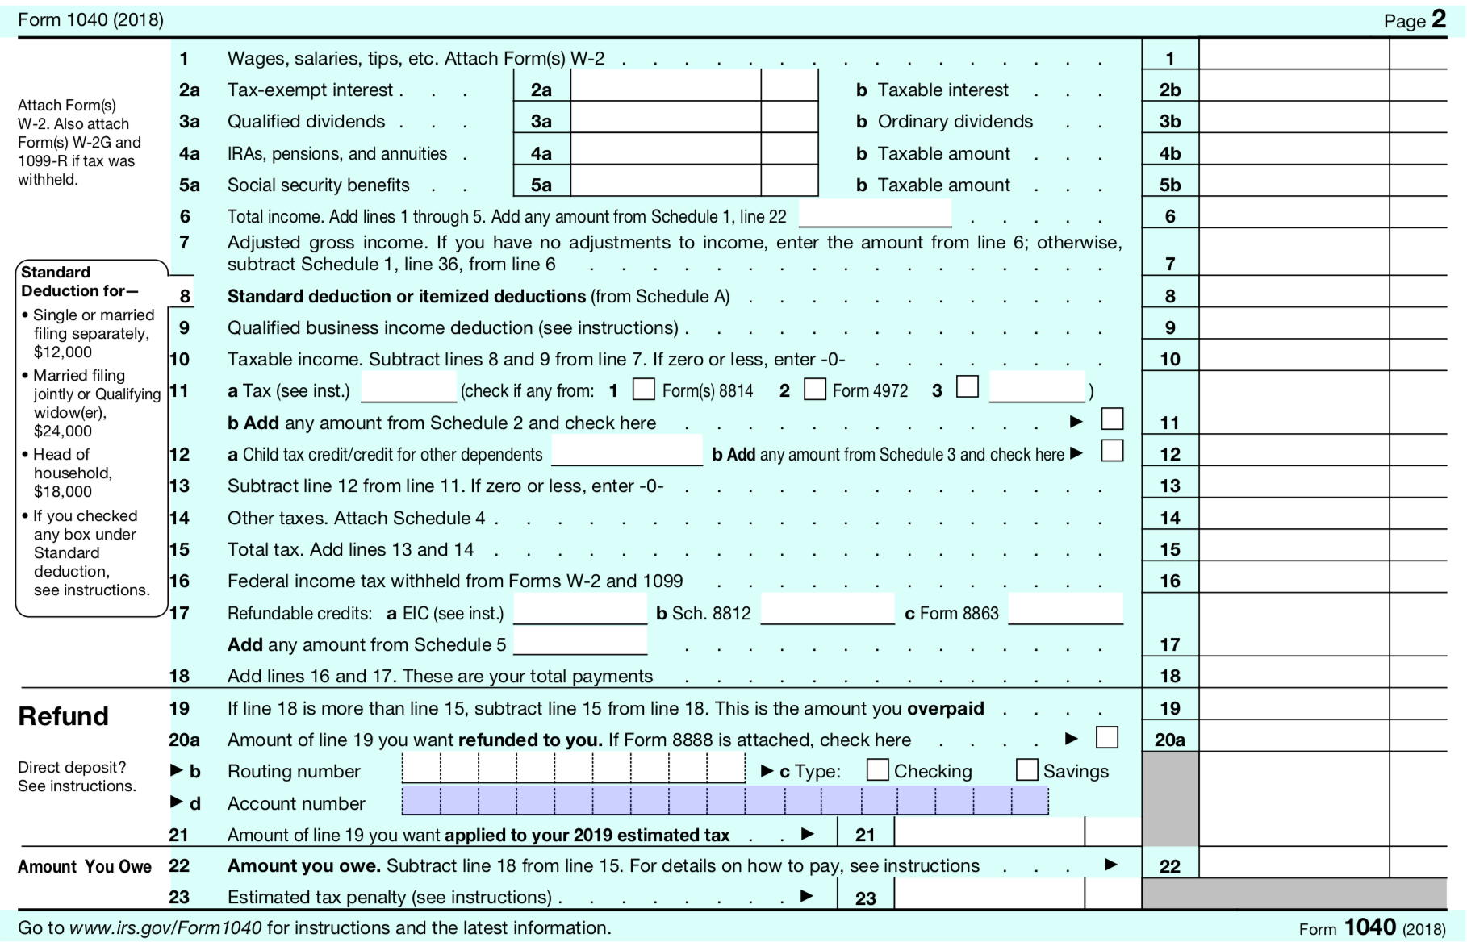
Look at Data. What Fields are Available?

Slide 24
Tax Preparer Fraud Solution Approach
First fully understand the business problem:
seeking tax preparer, not tax payer fraud
Fully understand current flagging and investigative process:
Investigators looking for connections between returns, all manual and in their heads
Simple solution:
Build a fraud score for each return
Aggregate summary information at the tax preparer level
Sort tax preparers by a summary fraud score and present summarized info to investigators in an efficient way

Slide 25
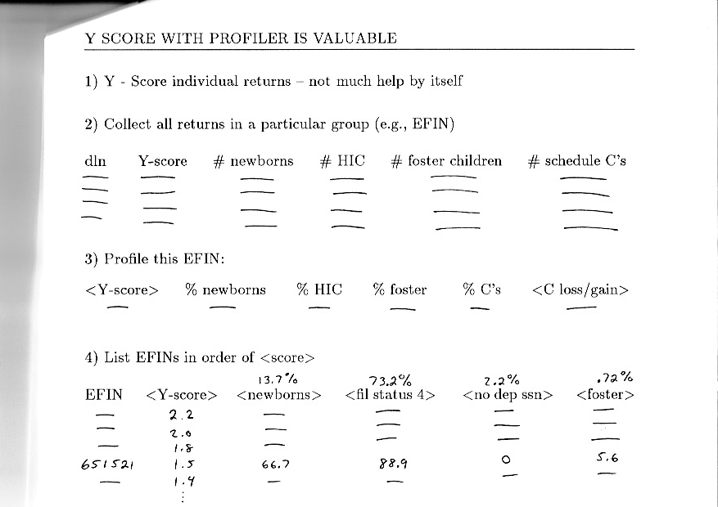
Score for individual tax returns
Aggregate tax returns by preparer
Summary statistics for each preparer
Sort preparers by average badness

Slide 26
Kinds of Data Fields
Numeric
Could be continuous or discrete (e.g., integer counts)
There is a metric – a concept of order and nearness
Ordinal – there is a metric, a natural ordering
Categorical or Nominal
There is no natural ordering
Examples: A, B, C… or Type 1, Type 2, Type 3…
These are different from numbers because there is no metric, no sense of nearness or ordering
Date/Time
20180118, 1/18/2018, 2018-01-18T14:22:38…
Text
Examples: John Smith, 111 Main Street…
Free text in sentences, paragraphs or a document
Just a string of characters like 0b9717s93f90g8r34

Slide 27
Basic Statistics
Covariance of any two columns:
Column standard deviation:
Correlation of any two columns:
Covariance matrix:
Correlation matrix
Many hundreds
x₁ x₂ x₃ … x_{n} y
x₁ x₂ x₃ … x_{n} y
Many
millions
x₁ x₂ x₃ … x_{n} y
x₁ x₂ x₃ … x_{n} y
Distribution of a column
x₁ x₂ x₃ … x_{n} y
x₁ x₂ x₃ … x_{n} y
…
Standard deviation
Data matrix
X is tall and thin
mean
m rows, n+1 columns; m>>n (why?)
x’s are the independent variables; y is the dependent variable
Column minimum, maximum
Column mean (average):
Symmetric
Diagonals are the variances
Symmetric
Diagonals are all 1

Slide 28
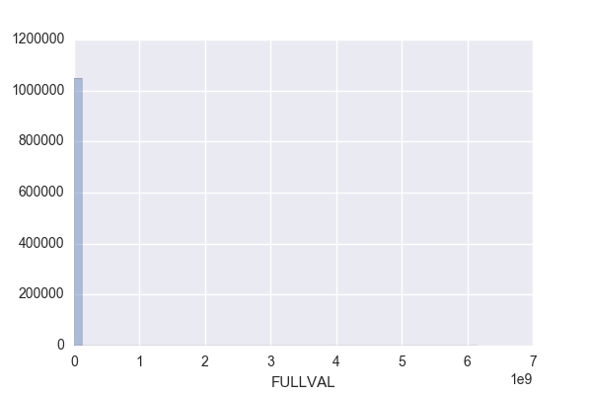
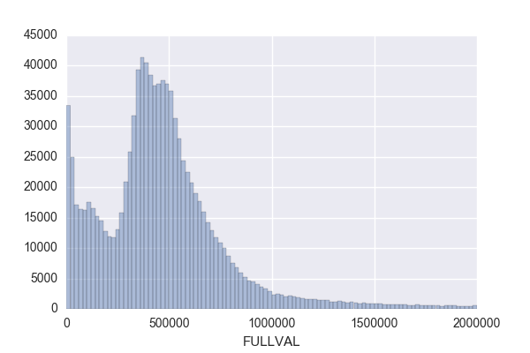
How to Look at a Numeric Field
Calculate the basic statistical properties: % populated, mean, standard deviation, max, min
Look at the distribution or histogram
This picture doesn’t show a lot of information
This picture is much better. It shows the nature of the distribution.

Slide 29
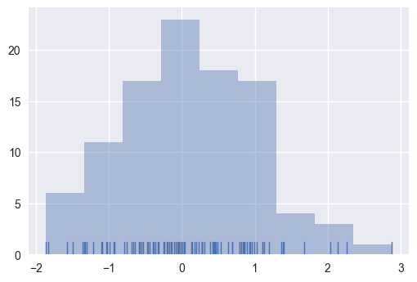
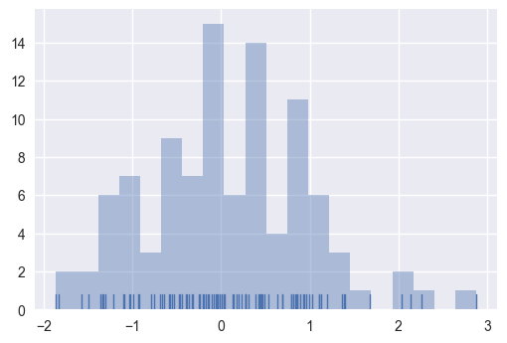
Plotting Distributions: Choosing Number of Bins
Too few bins
# records with that value of x
Look at max, min, mean, sd’s, distributions, do normalizations
Value of x
x₁ x₂ x₃ … x_{n} y
x₁ x₂ x₃ … x_{n} y
Many
millions
x₁ x₂ x₃ … x_{n} y
x₁ x₂ x₃ … x_{n} y
x₁ x₂ x₃ … x_{n} y
…
Too many bins
Many hundreds
# records with that value of x
Value of x

Slide 30
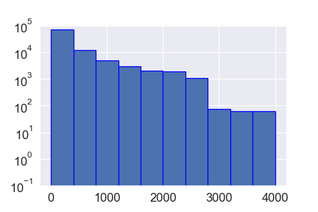
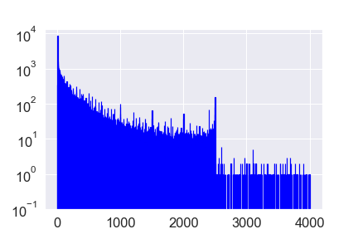
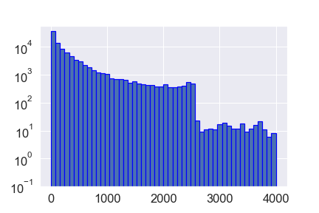
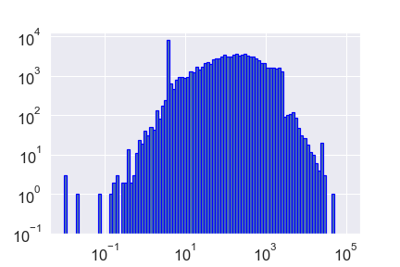
Plotting Distributions: Choosing Number of Bins
Too few bins:
too coarse
Too many bins:
spikey
Good choice:
Shows the important information without being spikey
Sometimes, rarely, a log x axis can reveal important characteristics

Slide 31
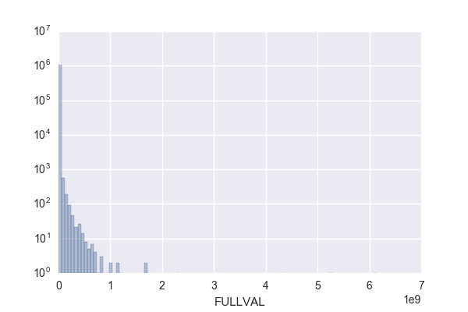
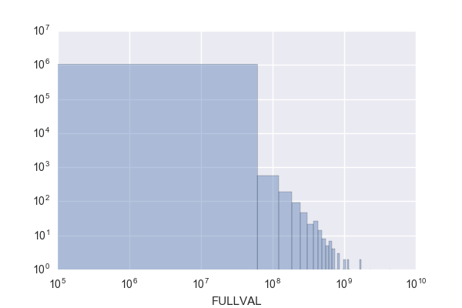
Use Good Choices of Ranges and Logs for Plots
First try, not good
Try a log y axis, a little better
Better choice of x range
Generally, don’t do a log scale for x

Slide 32
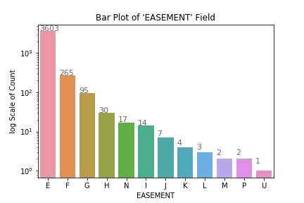
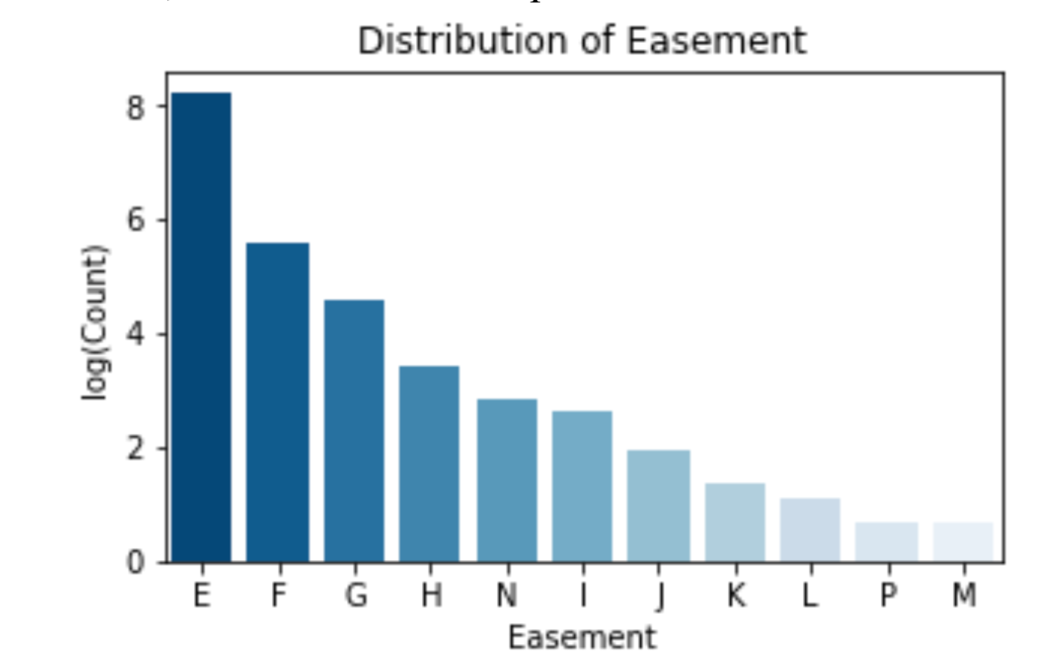
How To Do A Log Plot
Plot the item on a log scale, don’t plot the log of the item
Do this
Don’t do this
The pictures look the same but the y axis is very hard to interpret on the “bad” picture

Slide 33
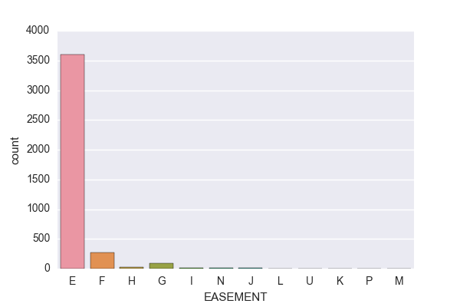
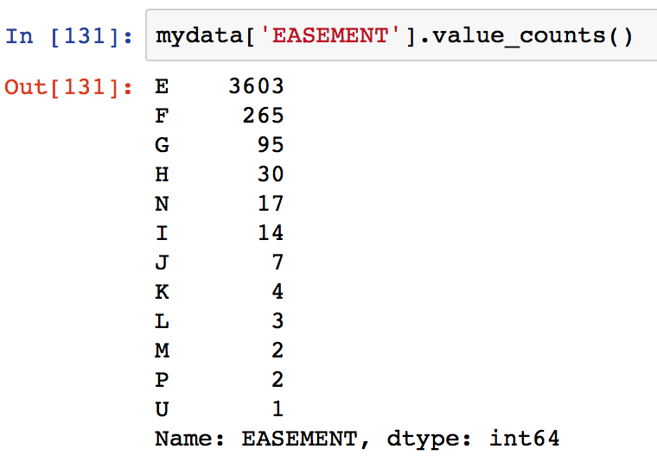
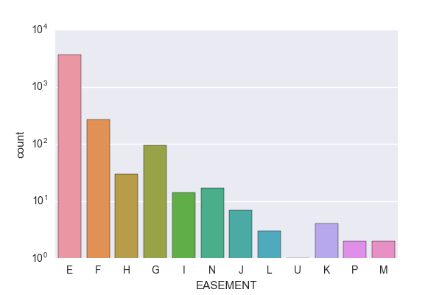
How to Look at a Categorical Field
Calculate the basic statistical properties: % populated, number of unique values
Look at the distribution, either as a histogram or a table

Slide 34
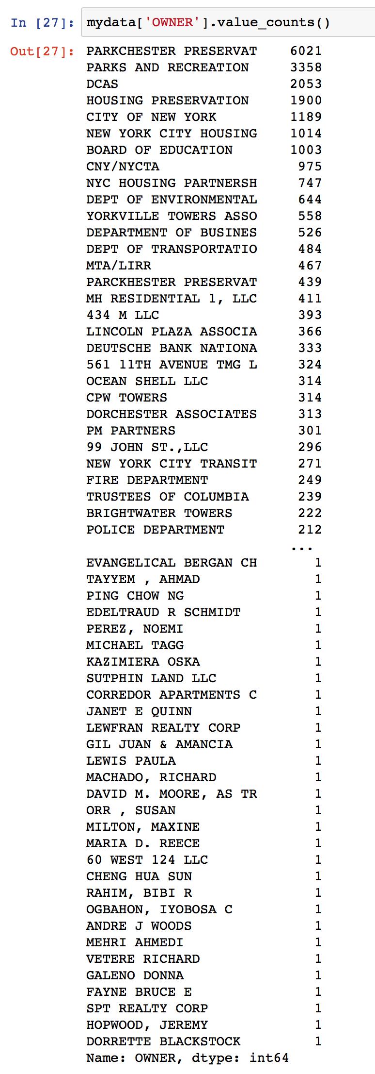
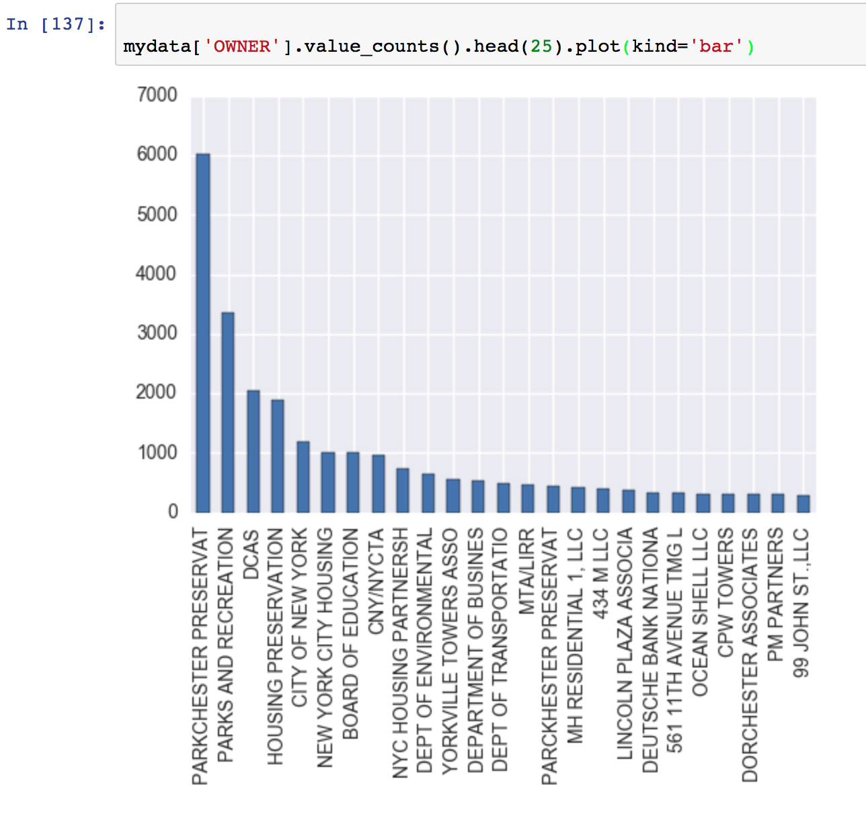
How to Look at a Long Categorical Field
You can print a partial list or a histogram of the top n values

Slide 35
Project 1: Find Anomalies in NY Property Data
You’ve just been hired by the city of NY. They think there might be some property tax fraud going on in their city, but they’re not sure.
They have no idea how to discover this.
They want you to build an algorithmic system that can look through their ~1 million property records to find potential tax fraud.
The kind of fraud they’re looking for is people underpaying tax or otherwise misrepresenting their property characteristics.

Slide 36
Project 1 – Unsupervised Fraud Model on NY Property Data
Data is ~1 million records, ~30 fields, somewhat messy
Data is posted on Blackboard as a .csv file
Work in teams ~4 – 7 people. Make sure all contribute.
Project 1 report due 2/13 noon
Each person in the team submits the same report on Blackboard

Slide 37
Look at NY Property Data
Here is a little information about the NY data. I found it here:
https://data.cityofnewyork.us/Housing-Development/Property-Valuation-and-Assessment-Data/rgy2-tti8
You don’t need to get the data from here; it’s posted on Blackboard

Slide 38
What is a Data Quality Report (DQR)?
A DQR is a preliminary quantitative analysis that explores and documents the basic characteristics of a data file
It is
Basic info about the file (how many records, time period, source…)
Summary statistics for each field
Percent populated, # zeros
Numeric: min, max, mean, sd, distribution/histogram
Categorical: # values, histogram or table of values, top several values
It serves as (1) a check with the business to make sure the data is correct, (2) help you get familiar with the data, and (3) a resource for when you start to build variables

Slide 39
Homework 1, Due 1/23: DQR on NY Property Data
Build a Data Quality Report for the NY property data
Report should be a Word document
Professional business report: good formatting, good grammar, no spelling errors
Good formatting on all your data plots: good choices of scales (log, linear, ranges), legible labels
Include page numbers

Slide 40
Data Quality Report Has 3 Sections
First, a high-level description of the data: what it is, where it came from, the time period it covers, number of fields, number of records (just a few sentences)
Then a summary table(s) listing all fields with summary information:
Field name, field type (categorical, numeric, date/time…), # records that have a value, % populated, # unique values, # records with value zero
If numeric: mean, standard deviation, min, max
If categorical: most common field value
Could be a single table or two separate tables, one for numerical and one for categorical fields
Then for each field* in the order they appear in the data:
Short description of the field, then a “picture”:
Numeric: a distribution, noting any outliers that are omitted
Categorical: a bar chart/histogram or a table of the top 10 to 15 field values
Make good choices of ranges, scales (linear or log), label font sizes
*Don’t need a distribution for the record number, just a statement that it’s a unique integer label for each record

Slide 41
Look at NY Data

